Slide 1




Peet’s Coffee Semi-Annual Forecasting
By: Amy Rivera, Jaslynn Dang, Shruti Hardasani

Slide 2


Table of Contents
1A
1B
Background
Problem
2A
2B
2C
Calculations
Analysis
Conclusion

Slide 3


01
Background Info
Background, Problem

Slide 4
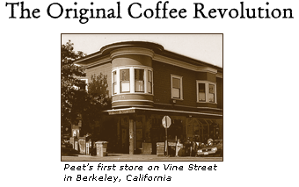
Origin of Peet’s
Kicking off in 1966 in a self-owned coffee shop in Berkeley by Alfred Peet
Peet’s Coffee had found success in the experimentation of various blends and roasts
Began with the ambition of redefining how Californians consume coffee
Established the use of dark roast blends in California,
Famed for their unique roasts and blends

Slide 5

334 total stores nationwide
Peet’s Coffee Today Currently Operates…
242 in which reside in California!

Slide 6



Problem:
With Peet’s Coffee’s nationwide success, it is essential that they gather as much necessary information in regards to their operations, to ensure fluid and smooth-sailing functions
Foreshadowing prospective revenue
Aids in anticipating future variables (financially)
Allocation of expected funds
Utilizing revenue
Weighted Moving Average Method
Best suited due to presence of general data trend
Applies heavier weight onto recent data
Able to follow recent data trends + use past financial reports to examine cycles and trends to reference

Slide 7

02
Forecasting
Calculations, Analyzations, Conclusions

Slide 8

Fᵢ=0.4Aᵢ₋₁+0.3Aᵢ₋₂+0.2Aᵢ₋₃0.1Aᵢ₋₄
Equation Used:
Heavier weight focused on recent most data value
Four data points chosen in forecast calculation to reflect cycles shown in (actual) data

Slide 9
Semi-Annual
Forecast
Period | Actual (In Eur. Millions) | Forecast (In Eur. Millions)
1: H1 2018 | 3,173.00 | -
2: H2 2018 | 3,492.00 | -
3: H1 2019 | 3,332.00 | -
4: H2 2019 | 3,612.00 | -
5: H1 2020 | 3,326.00 | 3,460.10
6: H2 2020 | 3,325.00 | 3,429.60
7: H1 2021 | 3,254.00 | 3,383.40
8: H2 2021 | 3,747.00 | 3,325.50
9: H1 2022 | 3,896.00 | 3,472.60
10: H2 2022 | 4,255.00 | 3,665.80
11: H1 2023 | 3,988.00 | 3,945.60
12: H2 2023 | - | 4,025.60
When testing weight ratios, having “four” data points in our forecast had adequately accounted for the subsequent rises and falls in the provided data

Slide 10
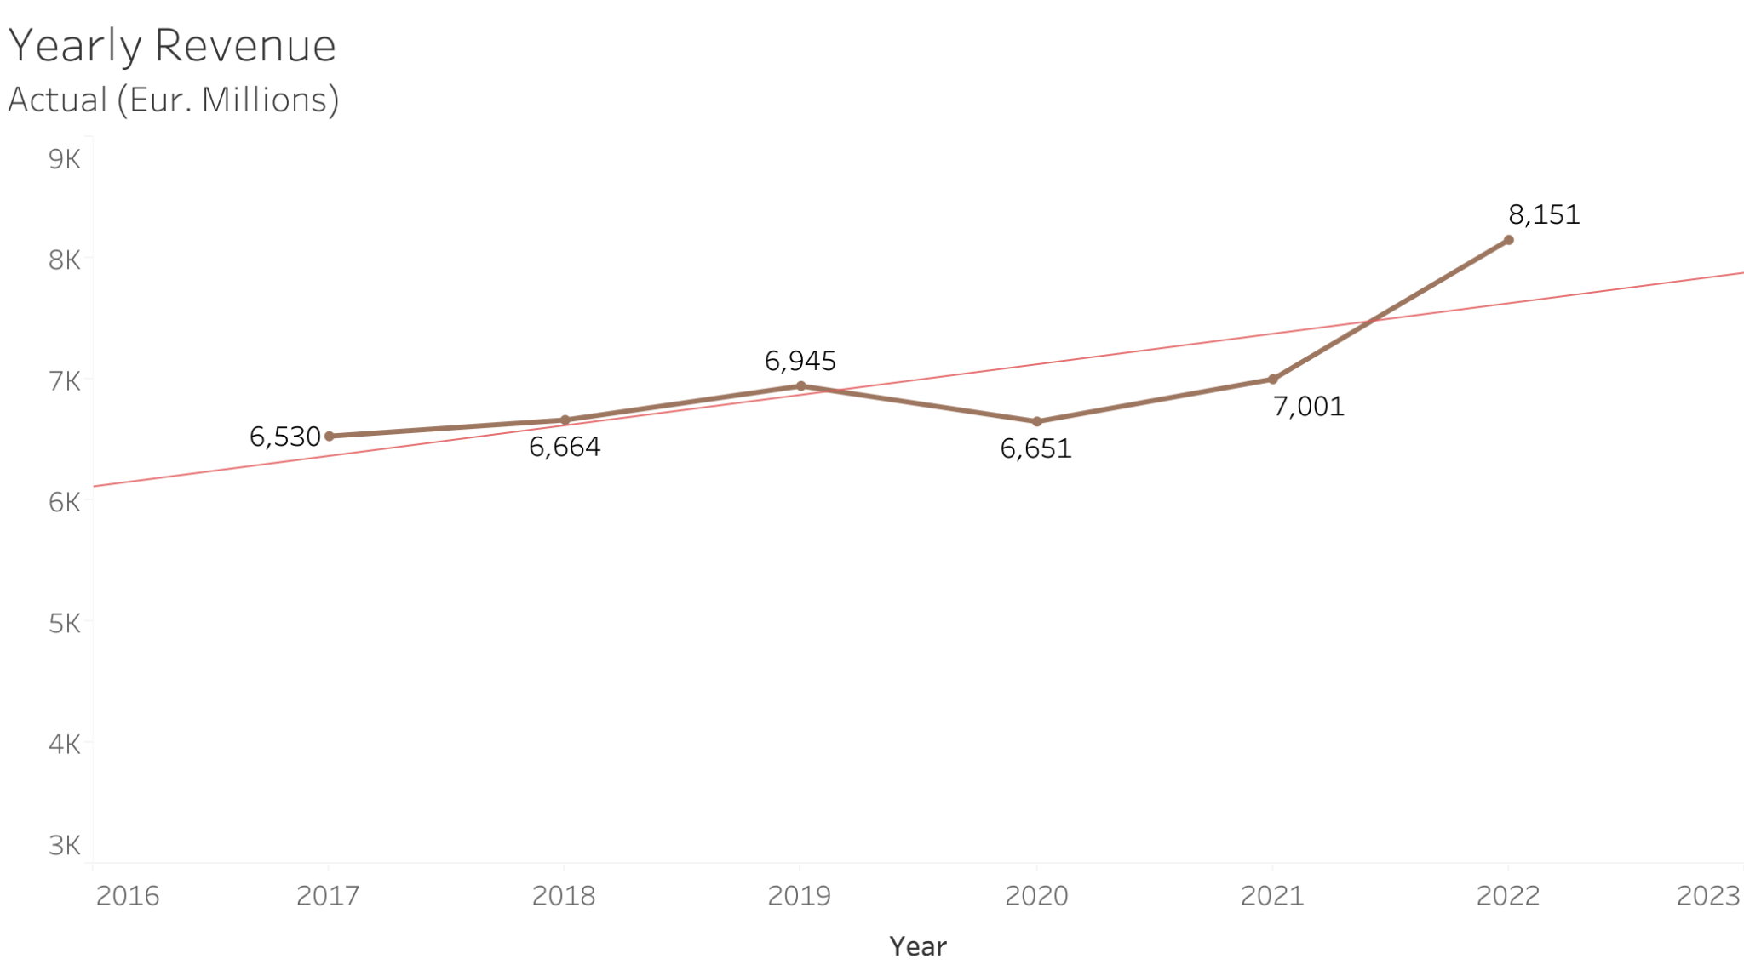
Yearly Revenue

Slide 11
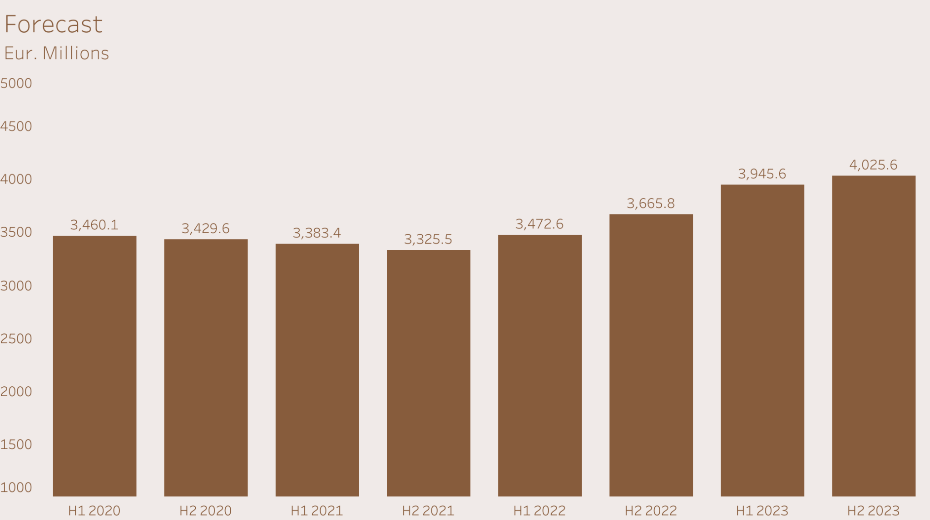
Forecast

Slide 12
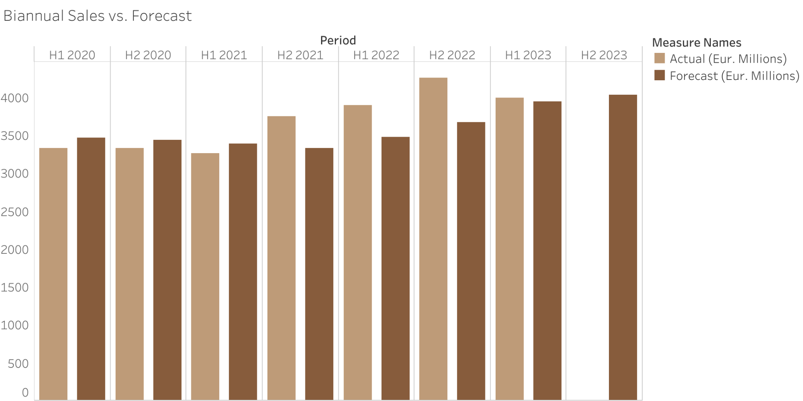
Forecasted Values Vs. Actual

Slide 13


Analysis
How does weighted moving average reflect the ebbs and flows of the company?
How does forecasting revenue benefit the company?
Forecasting based on recent data
Applying weight on recent observations are better indicators
Accounting for deviations in data
Able to utilize to:
Predict allocation of funds for production funding, marketing, etc.
Look into upcoming pricing
Look into financial stance of launching new ideas
Budgetary planning and cost control

Slide 14

Conclusion
Through implementing weighted moving average forecasting at Peet’s Coffee:
Effectively promote strategic decisions with several multifaceted benefits
Address challenges of budgeting/fund allocation and utilization of profits
Overall aiding Peet’s Coffee in properly navigating the complexities of the landscape and industry of business to push the brand to greater heights!

Slide 15
Resources
www.jdepeets.com/investors/financial-reports/annual-reports/#
www.sfchronicle.com/food/restaurants/article/peets-coffee-union-17744780.php
www.kqed.org/news/71145/peets-coffee-tea-sold-to-german-conglomerate-for-almost-1-billion
www.jdepeets.com/siteassets/documents/jde-peets-historical-financials.pdf
www.jdepeets.com/siteassets/documents/jde-peets-half-year-results-2022-report.pdf
www.peets.com/pages/timeline

Slide 16


Thank You! ◡̈

